Slide 1
NOISELESS CHANNEL -by Hitesh Nautiyal

Slide 2
Definition:-
An ideal channel in which no frames are lost, duplicated or corrupted is regarded as Noiseless Channel.
A noiseless channel is a communication system in which the signal transmitted from the sender to the receiver is free from any unwanted background noise or interference.

Slide 3
Simplest Protocol :-
In simplest protocol, there is no flow control and error control mechanism. It is a unidirectional protocol in which data frames travel in only one direction (from sender to receiver).
Also, the receiver can immediately handle any received frame with a processing time that is small enough to be negligible.
The protocol consists of two distinct procedures :a sender and receiver. The sender runs in the data link layer of the source machine and the receiver runs in the data link layer of the destination machine. No sequence number or acknowledgements are used here.

Slide 4
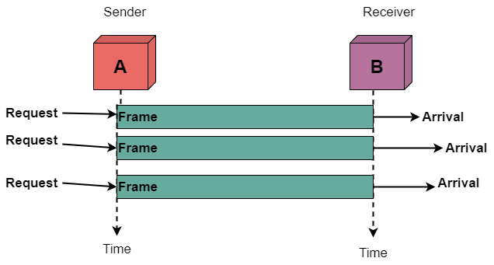
Flow Diagram of Simplest Protocol :-

Slide 5
Stop and Wait Protocol :-
The simplest retransmission protocol is stop-and-wait.
Transmitter (Station A) sends a frame over the communication line and then waits for a positive or negative acknowledgement from the receiver (station B).
If no error occurs in the transmission, station B sends a positive acknowledgement (ACK) to station A.
Now, the transmitter starts to send the next frame. If frame is received at station B with errors, then a negative acknowledgement(NAK) is sent to station A. In this case, station 'A' must retransmit the old packet in a new frame.
There is also a possibility that the information frames or ACKs may get lost.
Then, the sender is equipped with a timer. If no recognizable acknowledgement is received when the timer expires at the end of time out interval, the same frame is sent again.
The sender which sends one frame and then waits for an acknowledgement before process is known as stop and wait.

Slide 6
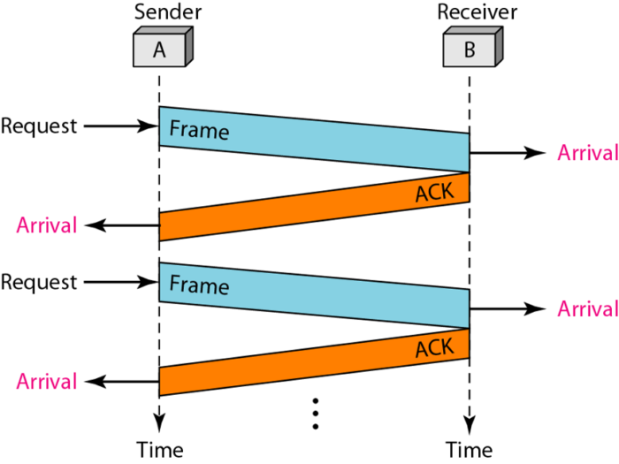
Flow Diagram of Stop and Wait Protocol :-

